Slide 1
Disk Defragment
What is the purpose of using the disk defragmenter?
What are contiguous files?
What are fragmented files?
What are unmovable files?
Why should you disable a screensaver while defragmentation process?
How do you disable a screensaver?
How do you use the Disk Defragmenter?

Slide 2
What is the purpose of using the disk defragmenter?
Disk Defragmenter is a utility that is used to rearrange all files inside the computer hard drive in a perfect manner.

Slide 3
What are contiguous files?
Are those relative files which arranged together in the same area.

Slide 4
What are fragmented files?
Fragmented Files are relative files that are scattered through out the hard drive.
When files are saved, they are not necessarily placed all together. They only needs a binding link.
Therefore, they need to be organized.

Slide 5
What are unmovable files?
are permanent (stable) files that cannot be changed.

Slide 6
D
I
S
K
S
P
A
C
E

Slide 7
File (1-1)
File (1-2)
File (2-1)
File (2-2)
File (2-3)
D
I
S
K
S
P
A
C
E
File (3)
File (4-1)
File (4-2)
File (4-3)
File (4-4)

Slide 8
File (1-1)
File (5-1)
File (1-2)
File (5-2)
File (2-1)
File (2-2)
File (2-3)
D
I
S
K
*
S
P
A
C
E
File (3)
File (4-1)
File (4-2)
File (4-3)
File (4-4)
File (5-3)
Fragmented Disk

Slide 9
File (2-1)
File (2-2)
File (2-3)
File (3)
File (4-1)
D
I
S
K
#
S
P
A
C
E
File (4-2)
File (4-3)
File (4-4)
File (5-1)
File (5-2)
File (5-3)
Defragmented Disk

Slide 10
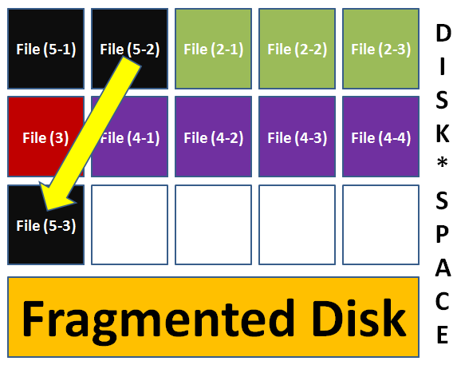

Slide 11
To do disk defragment, you should disable the Screensaver first. Why?
Because disk defragment is a continuous process takes long time to complete its task.
When the screensaver engages, it can interrupt the utility when it is working.

Slide 12
Thanks

